Slide 1
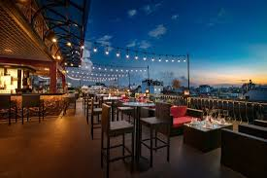
RESTAURANT FOOD ORDERING

Slide 2
TECHNO INDIA NJR INSTITUTE OF TECHNOLOGY
PRESENTED BY :
. DEVRAJ SINGH GEHLOT (20ETCCSO31)
. VISHAL SHARMA (20ETCCS116)
. DHRUV KUMAR SINGH (20ETCCS303)
. HARSH MENON (20ETCCSO31)
. ROHAN PRATAP SINGH (20ETCCSO96)
. GOURI KUMAWAT (20ETCCSO43)

Slide 3
OBJECTIVE :
The objective of a restaurant food ordering project using the MERN stack is to create a seamless platform for customers to browse menus, place orders, and make payments online. This involves building a user-friendly interface for customers to explore available dishes, customize orders, and track delivery. Additionally, the project aims to streamline operations for restaurant staff by integrating order management, inventory tracking, and customer feedback systems. By leveraging the MERN stack (MongoDB, Express.js, React.js, Node.js), the goal is to develop a scalable, responsive, and efficient application that enhances the dining experience for customers and improves the management process for restaurant owners.

Slide 4
MODULE :
CUSTOMER MODULE :
ADMINISTRATIVE MODULE :
. VIEW PRODUCTS
. PRODUCT BOOKING
. GIVE FEEDBACK
. VIEW PRODUCT BOOKINGS
. MANAGE PRODUCTS
. MANAGE CUSTOMERS
. MANAGE PRODUCTS
. MANAGE BOOKING

Slide 5
SCOPE & PURPOSE
SCOPE :
The scope of a restaurant food ordering project using the MERN stack includes developing a comprehensive system for online food ordering, encompassing features such as user authentication, menu browsing, order placement, payment processing, order tracking, and feedback collection. Additionally, the project may involve integrating admin functionalities for restaurant management, including menu updates, order management, inventory tracking, and analytics. Scalability and responsiveness are key considerations to accommodate potential growth and ensure optimal user experience across devices. Furthermore, the project scope may extend to implementing features like promotions, loyalty programs, and third-party integrations to enhance customer engagement and streamline operations.

Slide 6
PURPOSE :
The purpose of a restaurant food ordering project using the MERN stack is to modernize and streamline the dining experience for both customers and restaurant owners. By leveraging MongoDB, Express.js, React.js, and Node.js, the project aims to create a robust platform for online food ordering that enables customers to conveniently browse menus, place orders, and make payments. For restaurant owners, the system facilitates efficient order management, inventory tracking, and customer engagement through feedback mechanisms. Ultimately, the project's purpose is to enhance accessibility, improve operational efficiency, and foster customer satisfaction by providing a seamless and user-friendly interface for ordering food from restaurants.

Slide 7
PROPOSED SYSTEM :
The proposed system for a restaurant food ordering project using the MERN stack involves developing a dynamic platform where customers can effortlessly browse menus, customize orders, and complete transactions online. Leveraging MongoDB for database management, Express.js for server-side logic, React.js for interactive user interfaces, and Node.js for backend development, the system ensures scalability and responsiveness. Features include user authentication, menu management, order tracking, and feedback collection. Additionally, the system integrates admin functionalities for restaurant owners to manage orders, update menus, track inventory, and analyze performance. The goal is to deliver a seamless, efficient, and engaging online food ordering experience for both customers and restaurant staff.

Slide 8
SYSTEM DESIGN:
The system design of a restaurant food ordering project using the MERN stack involves creating a modular architecture where MongoDB serves as the database for storing menu items, user information, and order details. Express.js handles server-side logic, managing HTTP requests and routing. React.js facilitates dynamic and interactive user interfaces, allowing customers to browse menus and place orders seamlessly. Node.js powers the backend, coordinating communication between the server and client-side components. Integration of payment gateways and authentication systems ensures secure transactions. Additionally, RESTful APIs enable communication between frontend and backend, while scalability considerations ensure optimal performance as the system grows.

Slide 9
USE CASE DIAGRAM
The use case diagram for a restaurant food ordering project using the MERN stack illustrates key interactions between actors and the system. Actors include Customers, Admins, and the System itself. Use cases involve actions such as browsing menus, placing orders, making payments, managing orders (for admins), and updating menus (for admins). Customers interact with the system to view available dishes, customize orders, and track deliveries. Admins utilize the system to manage orders, update menus, and analyze performance. The system facilitates communication between users and the database, ensuring seamless operation and enhanced user experience throughout the food ordering process.

Slide 10
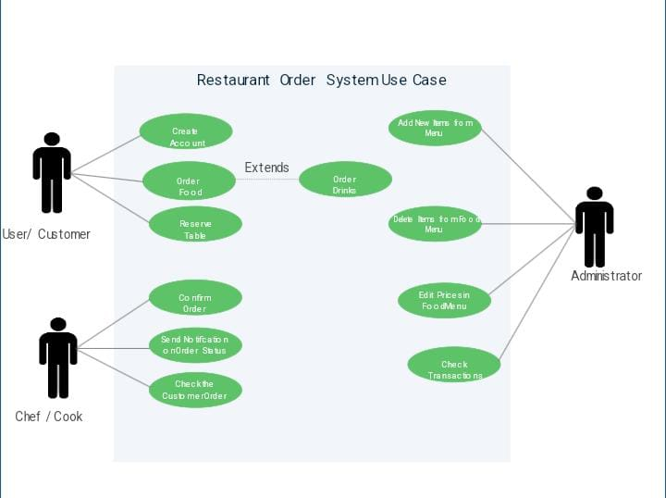

Slide 11
FRONTEND LANGUAGES USED :
REACT :
React (also known as React.js or ReactJS) is a free and open-source front-end JavaScript library for building user interfaces based on components. It is maintained by Meta (formerly Facebook) and a community of individual developers and companies. React.

Slide 12
BACKEND LANGUAGES USED :
EXPRESS:
Express, is a back end web application framework for building RESTful APIs with Node. js, released as free and open-source software under the MIT License. It is designed for building web applications and APIs. It has been called the de facto standard server framework for Node.
MONGODB:
MongoDB is a non-relational document database that provides support for JSON-like storage. The MongoDB database has a flexible data model that enables you to store unstructured data, and it provides full indexing support, and replication with rich and intuitive APIs

Slide 13
SOFTWARE USED :
VS CODE:
Visual Studio Code is a streamlined code editor with support for development operations like debugging, task running, and version control. It aims to provide just the tools a developer needs for a quick code-build-debug cycle and leaves more complex workflows to fuller featured IDEs, such as Visual Studio IDE.

Slide 14
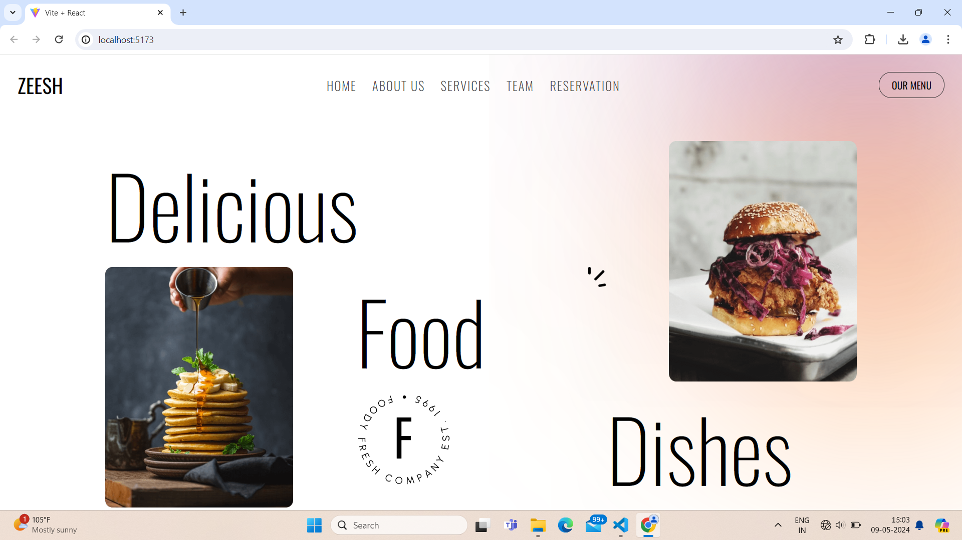
HOME PAGE :

Slide 15
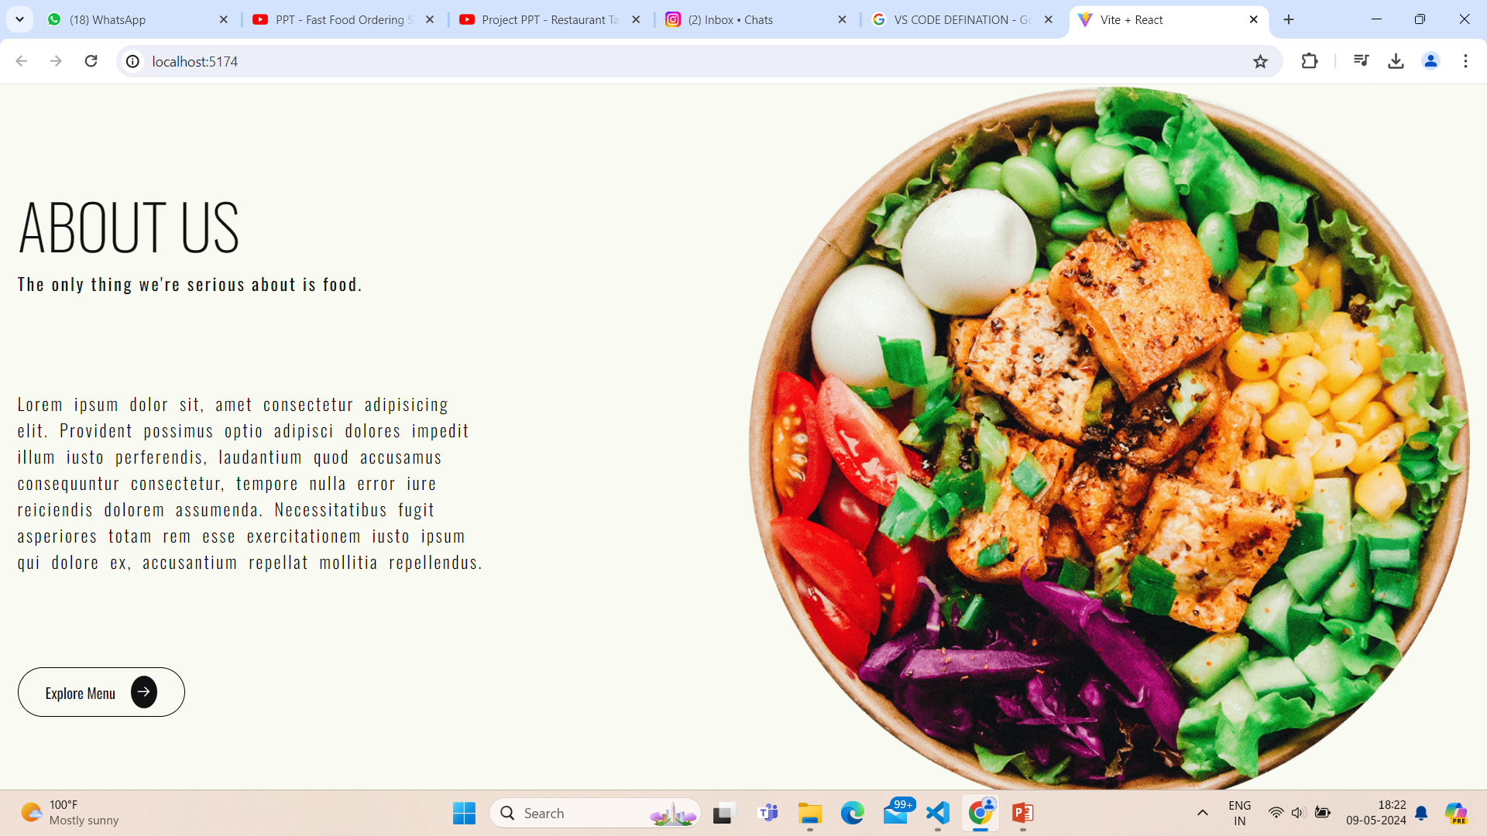
ABOUT US PAGE :

Slide 16
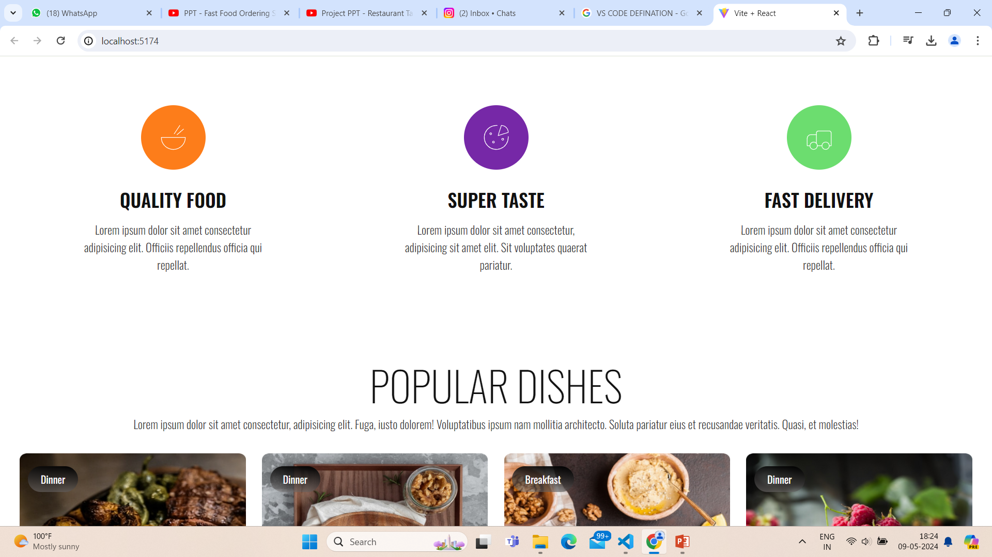
SERVICE PAGE :

Slide 17
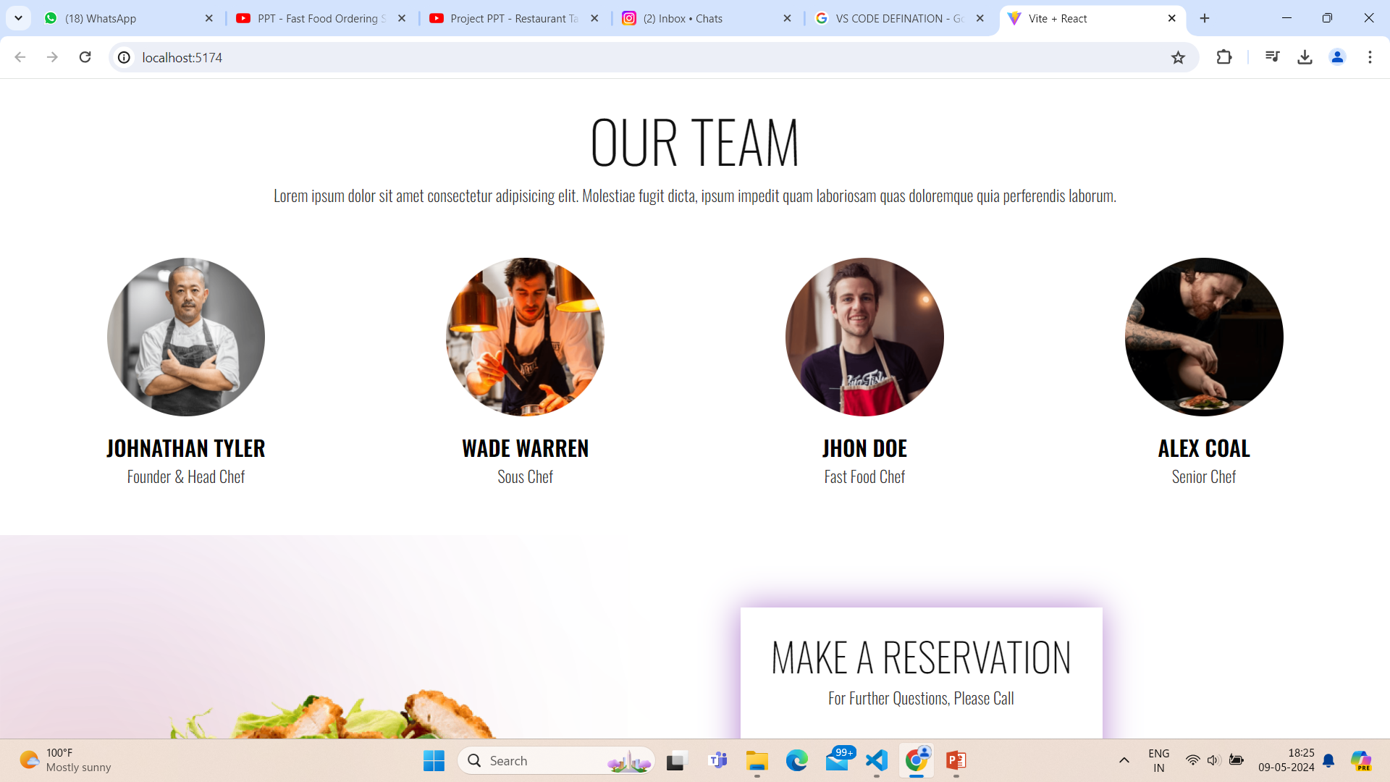
TEAM PAGE :

Slide 18
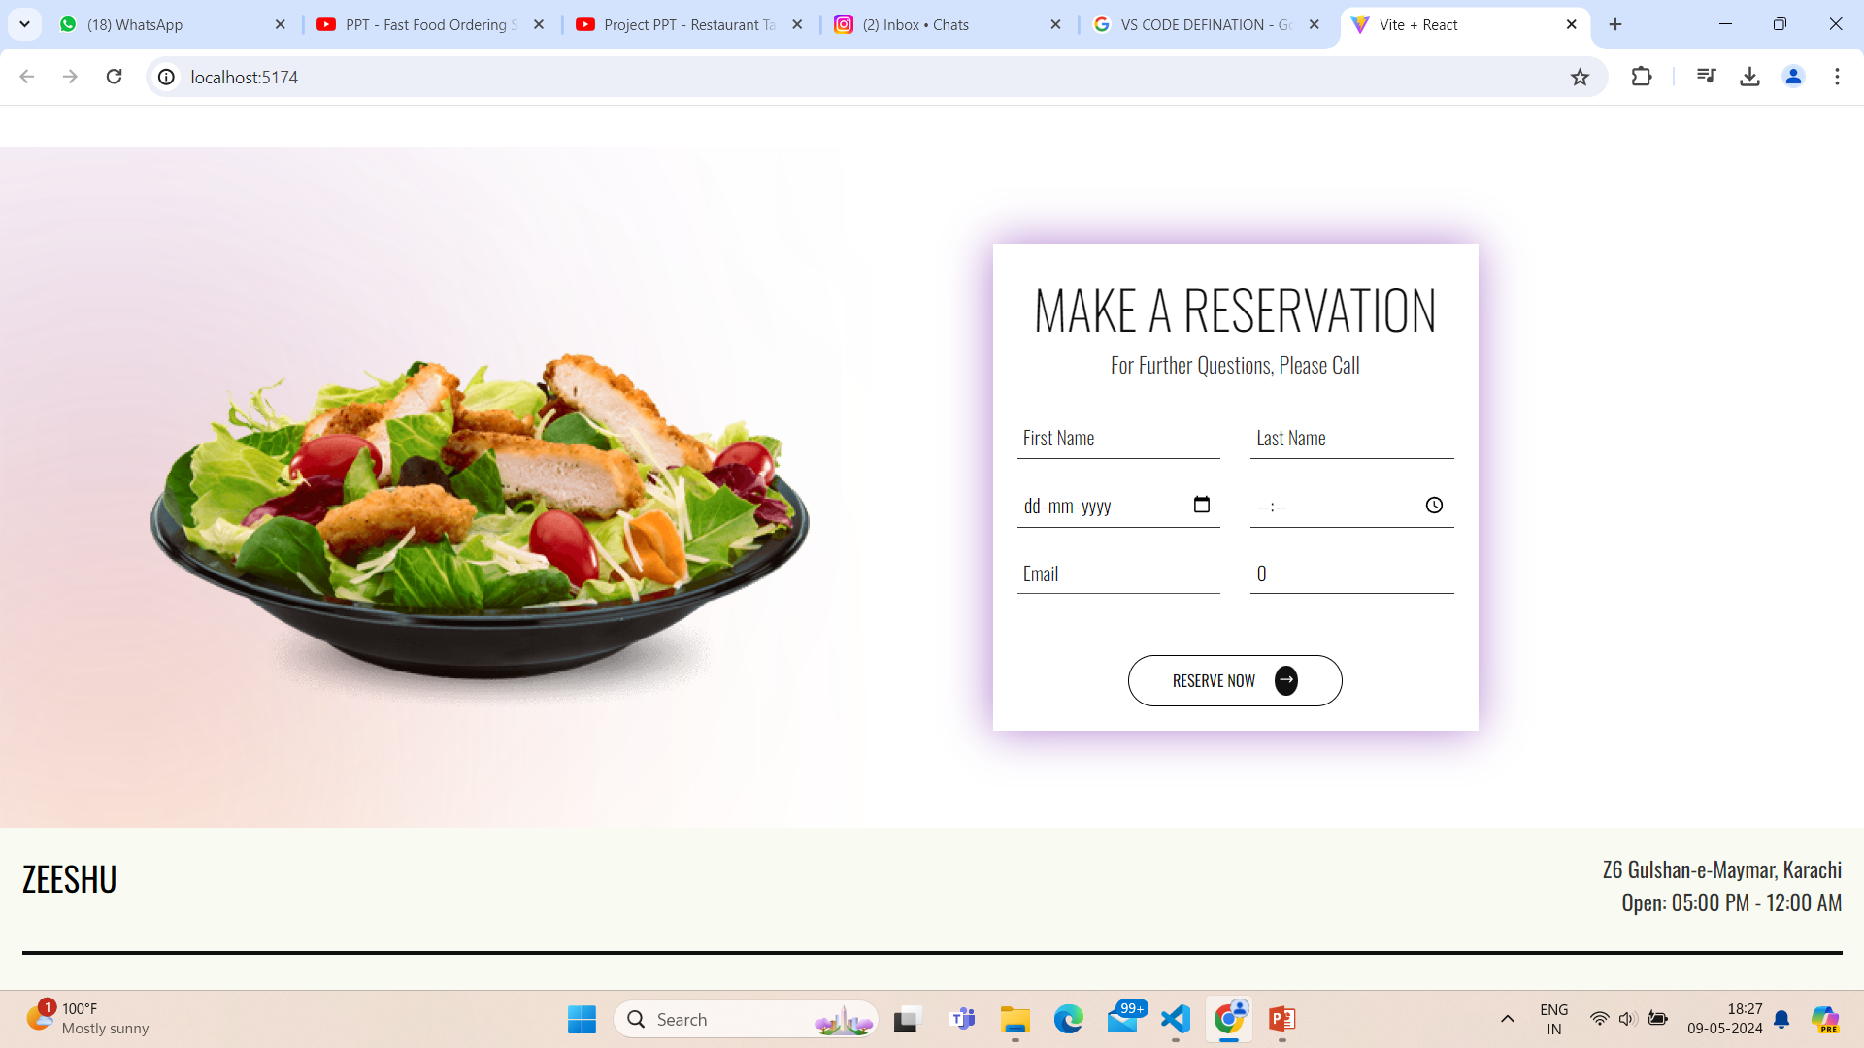
RESERVATION PAGE :

Slide 19
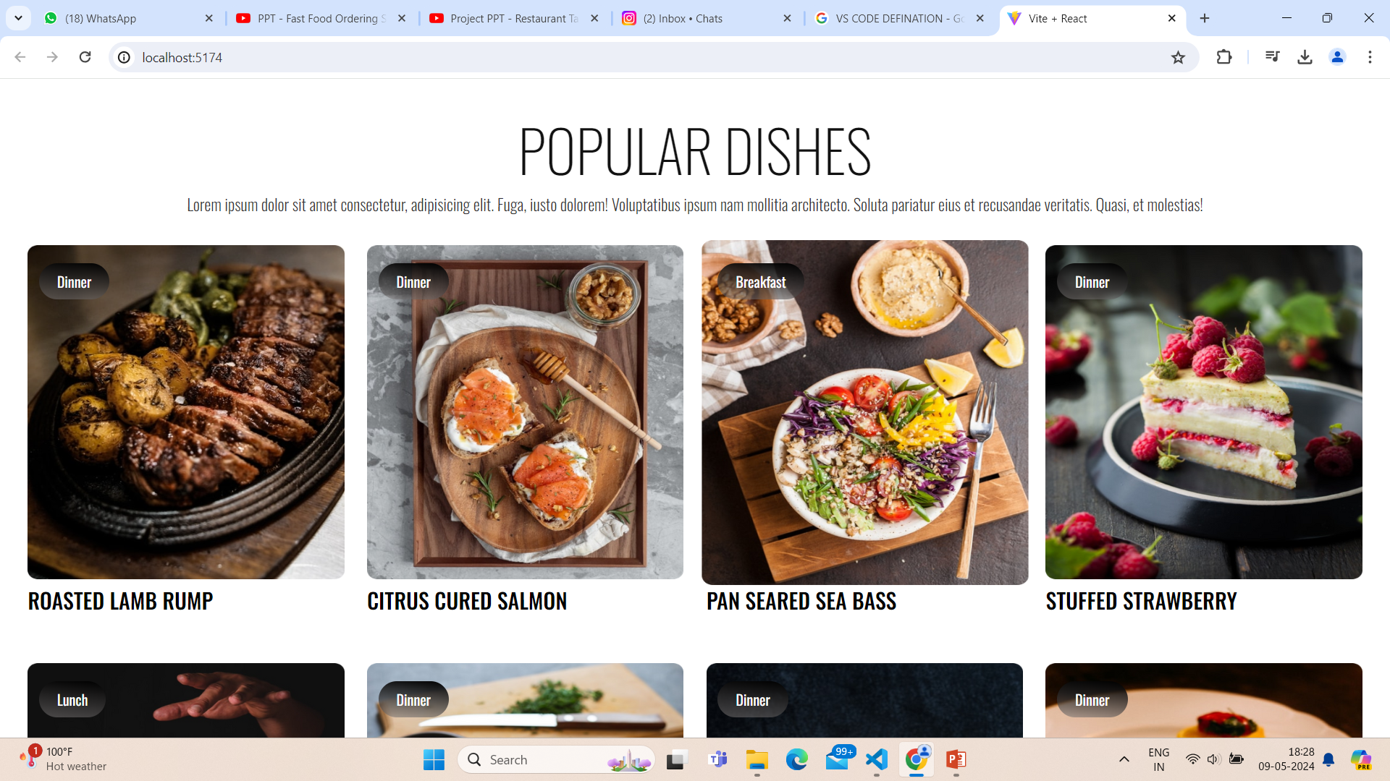
OUR MENU PAGE :

Slide 20
CONCLUSION & FUTURE SCOPE :
Conclusion:
the restaurant food ordering project utilizing the MERN stack presents a comprehensive solution for enhancing the dining experience. Through seamless integration of MongoDB, Express.js, React.js, and Node.js, the project streamlines operations for both customers and restaurant owners.
Future scope:
includes implementing additional features such as real-time order tracking, AI-based recommendation systems, and integration with emerging technologies like blockchain for enhanced security. Furthermore, expanding the platform to support multiple restaurants and geographical regions could broaden its reach and impact. Overall, the project lays a strong foundation for continuous improvement and innovation in the online food ordering industry.

Slide 21
BIBLIOGRAPHY :
. WWW.W3SCHOOLS.COM
. WWW.JAVATPOINT.COM
. WWW.DEVELOPER.COM

Slide 22
THANK YOU

